Slide 1

TASK - 5 VAPT TOOLS
PRACTICAL LEARNING
Vulnerability Assessment and Penetration Testing — Authorized
Local Lab Practical
NAME : B SAI AMULYA GOUD
SIN : DG/SEPTEMBER/CYBER/179

Slide 2
OBJECTIVE & LAB ENVIRONMENT
  To understand the basic concepts of Vulnerability Assessment and Penetration Testing (VAPT).
  To learn how to use Nmap for network scanning, open-port identification, and service detection.
  To use Nikto to identify common web-server security issues and missing security configurations.
  To learn the basics of Burp Suite as a web application security testing and HTTP proxy tool.
  To capture and analyze HTTP requests, headers, and cookies using Burp Suite.
  To identify and document at least three security findings from the practical testing.
  To understand security weaknesses in a controlled and authorized laboratory environment.
  To gain hands-on experience with commonly used VAPT tools while following ethical and authorized testing practices.
The Kali Linux machine was used as the security testing machine, while the Windows 7 virtual machine hosted the Nginx web server as the authorized target.

Slide 3
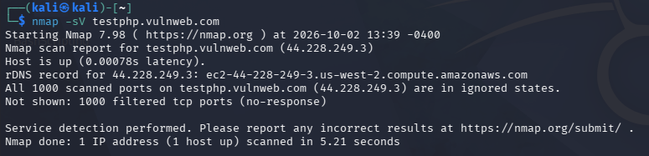
TASK 1 - NMAP NETWORK SCANNING
Nmap was used to perform network reconnaissance and identify available services on the authorized target testphp.vulnweb.com. Three scans were performed: SYN scan (-sS), service/version detection (-sV), and aggressive scan (-A). The scans showed that the target was reachable, but the 1000 scanned TCP ports were filtered with no response. The service detection scan did not identify any open TCP services. The aggressive scan also indicated that OS detection was unreliable because no open and closed ports were available for accurate fingerprinting. These scans provided basic information about the target's network accessibility, ports, and service-detection status.

Slide 4
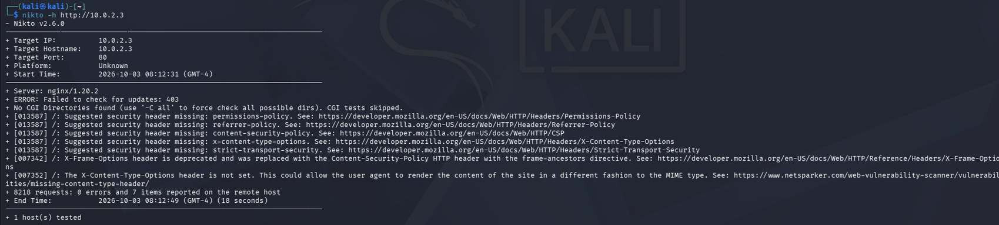
TASK 2 - NIKTO WEB VULNERABILITY SCAN
  TARGET : 10.0.2.3
Server: nginx/1.20.2
  RESULT : 8218 requests: 0 errors and 7 items reported

Slide 5
Finding 1 — Missing Content-Security-Policy (CSP)
The server does not define a CSP to restrict which resources browsers can load.
Finding 2 — Missing X-Content-Type-Options
The security header is not configured to prevent MIME-type sniffing.
Finding 3 — Missing Referrer-Policy
The server does not specify how much referrer information should be sent with requests.
NOTE : The assignment specified http://testphp.vulnweb.com as the safe external target. However, during testing it was unreachable on port 80 from the Kali environment, so the Nikto and Burp practical demonstrations were performed against the user's own authorized Windows 7/Nginx lab(10.0.2.3). This should be stated honestly in the report rather than attributing the local findings to VulnWeb.

Slide 6
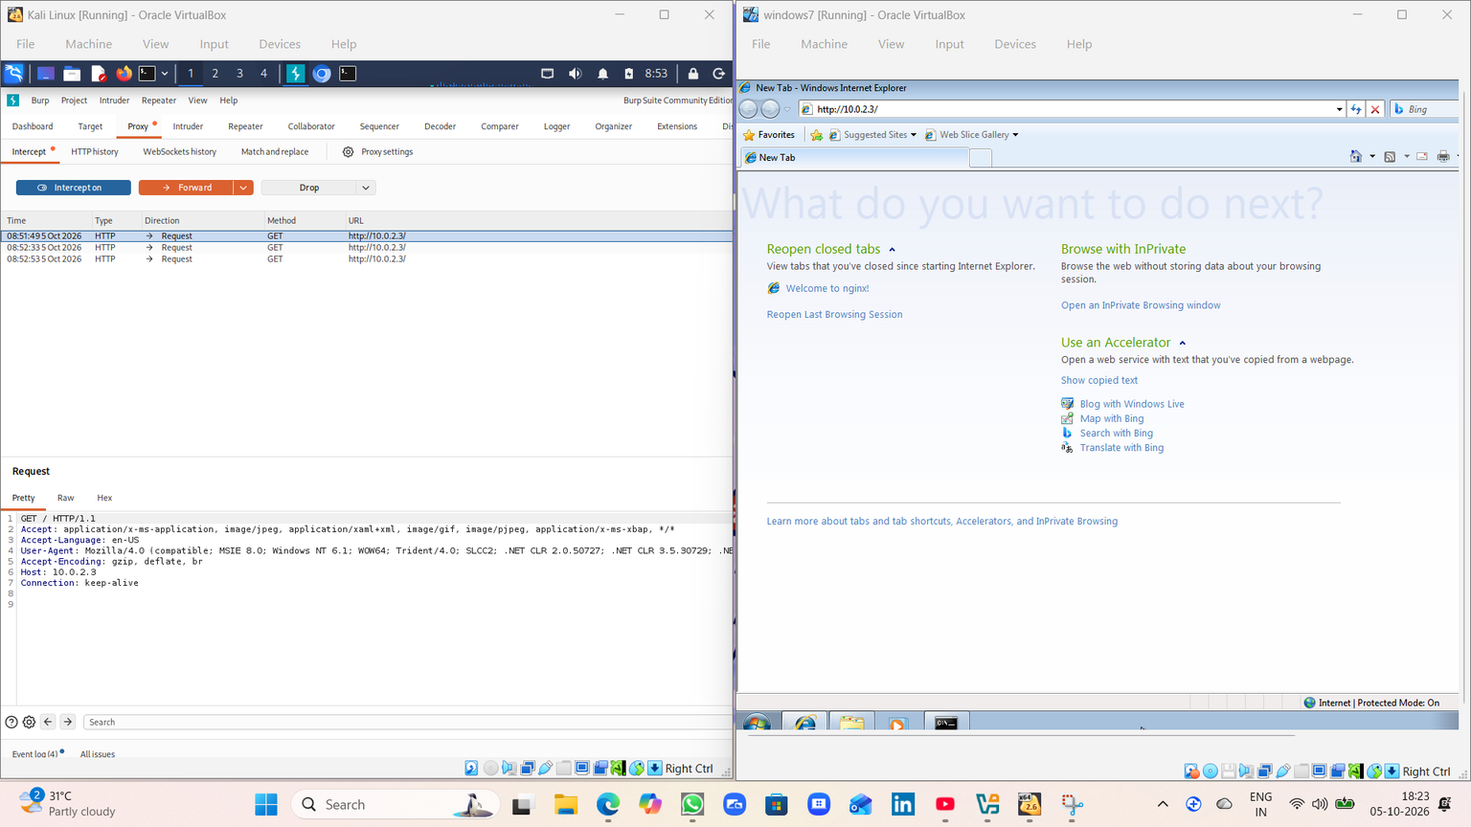
TASK 3 - BURP SUITE

Slide 7
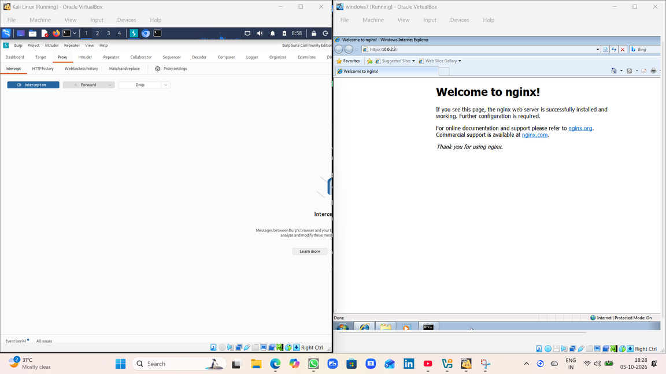
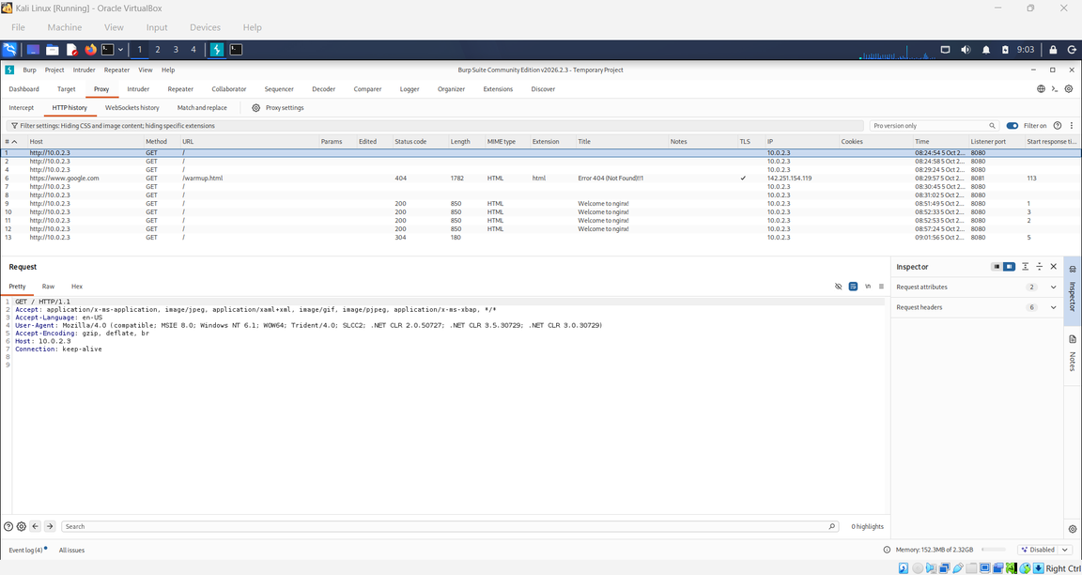
Burp Suite was used as an HTTP proxy and web security testing tool to intercept and analyze communication between the Windows 7 browser and the Nginx web server. A Burp Proxy listener was configured on 10.0.2.4:8080, and the Windows 7 browser was configured to route HTTP traffic through the Kali machine. HTTP requests to the authorized lab target 10.0.2.3 were successfully intercepted and analyzed. The captured requests were examined for details such as the HTTP method, host, user-agent, headers, and connection information. Burp Suite's HTTP History was also used to record multiple requests and their responses, including successful responses from the Nginx server.

Slide 8
CONCLUSION
·I Learned basic Nmap scanning techniques for host and service discovery
·I Identified web-server misconfigurations using Nikto
Captured and analyzed HTTP requests using Burp Suite
Understood ports, services and HTTP methods
· I Learned to interpret results rather than only running commands
·Understood the importance of authorization and ethical testing

Slide 9
THANK YOU

